Slide 1



Continual Learning: Methods and Applications
Jayanta Dey, PhD
Postdoctoral Research Fellow
https://www.nuailab.com
MATRIX AI Consortium, UTSA

Slide 2
Module Learning Aims
Aim 1: Learn what continual learning (CL) is
Aim 2: Methods to do CL
Aim 3: Datasets that can benefit from CL

Slide 3

Let’s look at Human Learning
Telugu Letters
Notes:
Example content slide

Slide 4
Notes:
Example content slide

Slide 5

Let’s look at Human Learning
Bengali Letters
Notes:
Example content slide

Slide 6
Notes:
Example content slide

Slide 7



Let’s test your learning
This letter belongs to which language?
Thumbs up for Telugu
Raised hand for Bengali
Notes:
Example content slide

Slide 8
Features of Human Learning
Can continuously learn different tasks
Improves on past and current tasks as they learn new tasks
3. Requires fewer samples to learn
Notes:
Example content slide

Slide 9

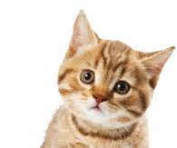
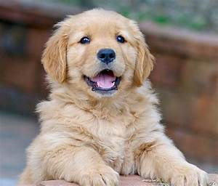
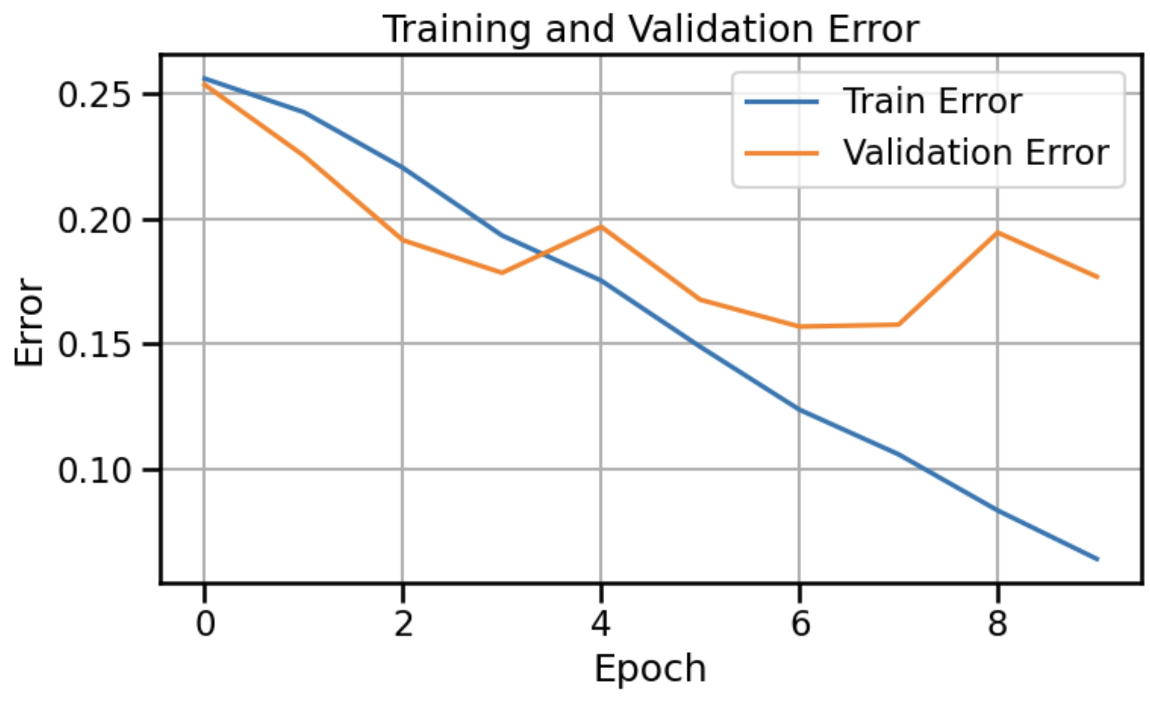
Let’s teach machines: Task1 (Cat vs Dog)
Recipe:
Training data (feature, label)
Learnable parameters
Loss function
Accuracy 82.31%
Successfully learns Task1 after seeing ~5000 samples per class!!!
Notes:
Example figure slide

Slide 10
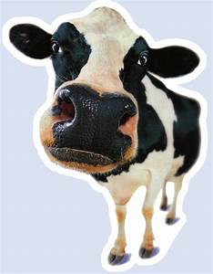
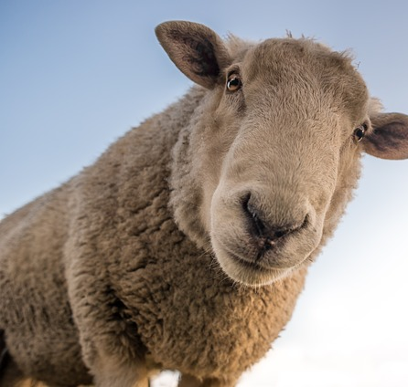
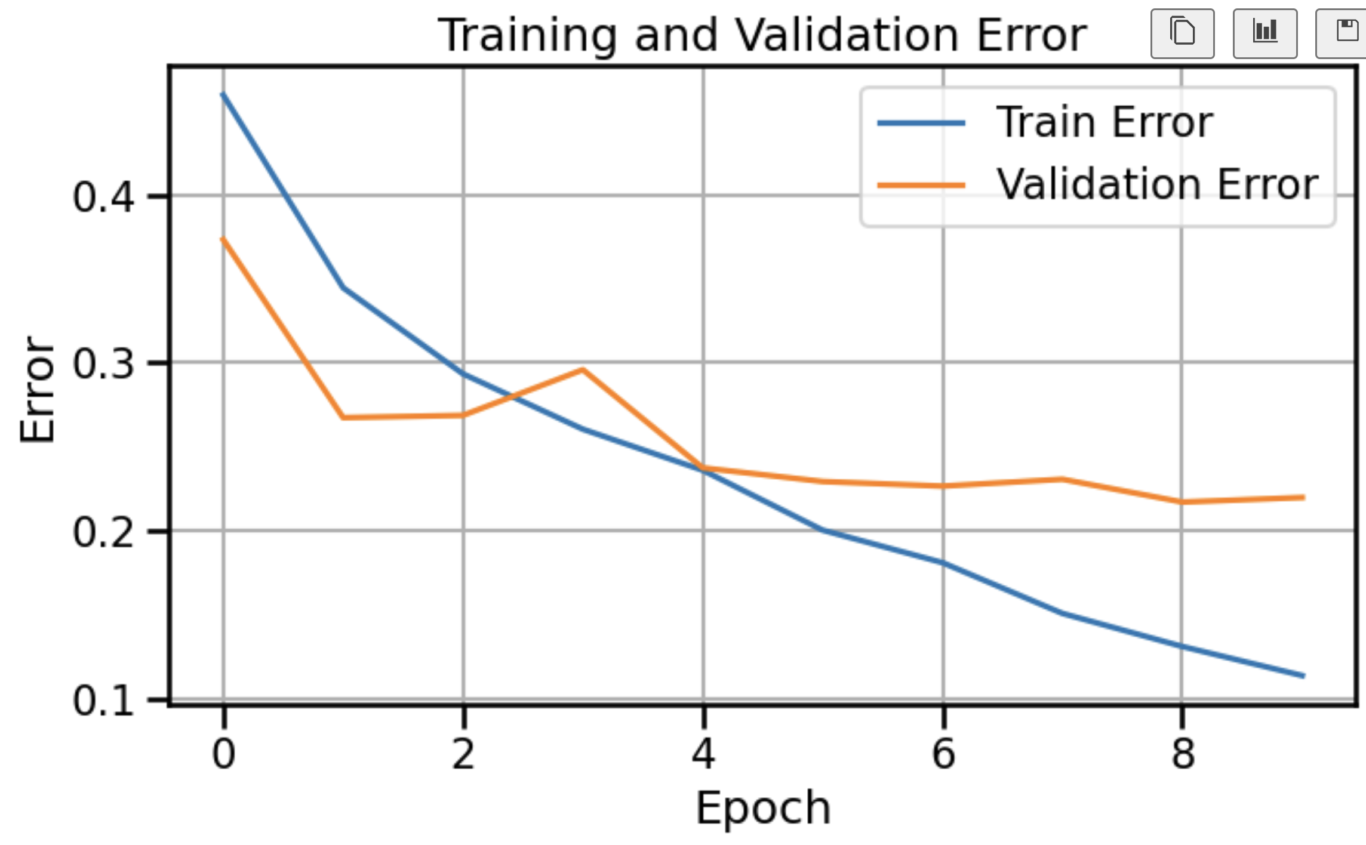
Let’s teach machines:
Task2 (Cow vs Sheep)
Recipe:
Training data (feature, label)
Learnable parameters
Loss function
Accuracy 78.02%
Successfully learns Task2
Notes:
Example figure slide

Slide 11
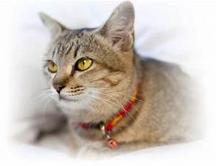
Let’s re-evaluate performance on Task 1
Task 1 accuracy got down to 45.94% from 82.31%
Successfully learns Task2,
But forgets Task1.
Dog!!!
Notes:
Example content slide

Slide 12
Problems with traditional machine learning
Forgets previous tasks when trained on new tasks
2. Is data hungry
3. Is resource hungry
Notes:
Example content slide

Slide 13
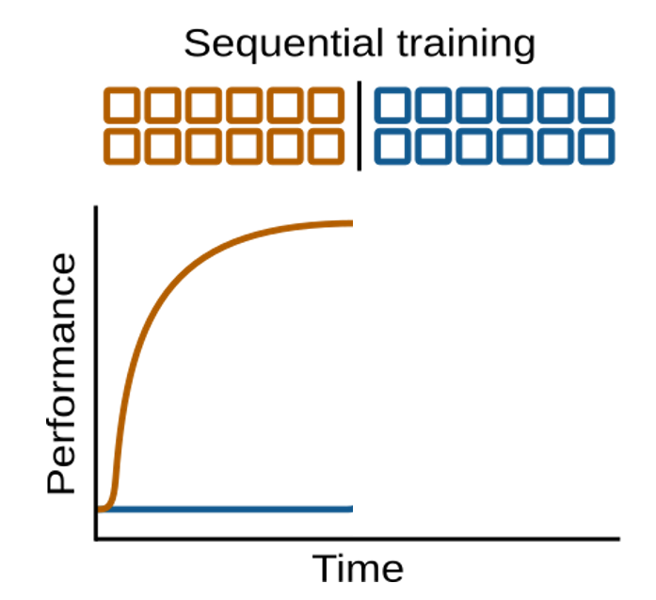

Catastrophic Forgetting
Performance on Task1 (yellow) is improving while being trained on Task1
Book Chapter: Van de ven, Soures, Kudithipudi, Continual Learning and Catastrophic Forgetting, arxiv 2024
Notes:
Example content slide

Slide 14
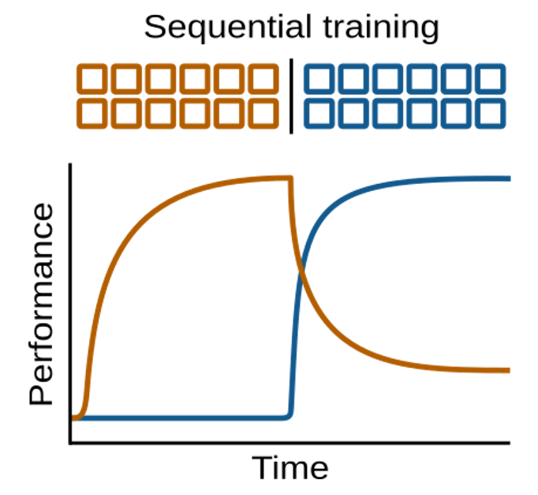
Catastrophic Forgetting
Performance on Task2 (blue) is improving while being trained on Task2,
But performance on Task1 (yellow) goes down.
Book Chapter: Van de ven, Soures, Kudithipudi, Continual Learning and Catastrophic Forgetting, arxiv 2024
Notes:
Example content slide

Slide 15
Catastrophic Forgetting: first mention
"Training on a new set of items may drastically disrupt performance on previously learned items."
-- McCloskey & Cohen, 1989
Notes:
Example content slide

Slide 16
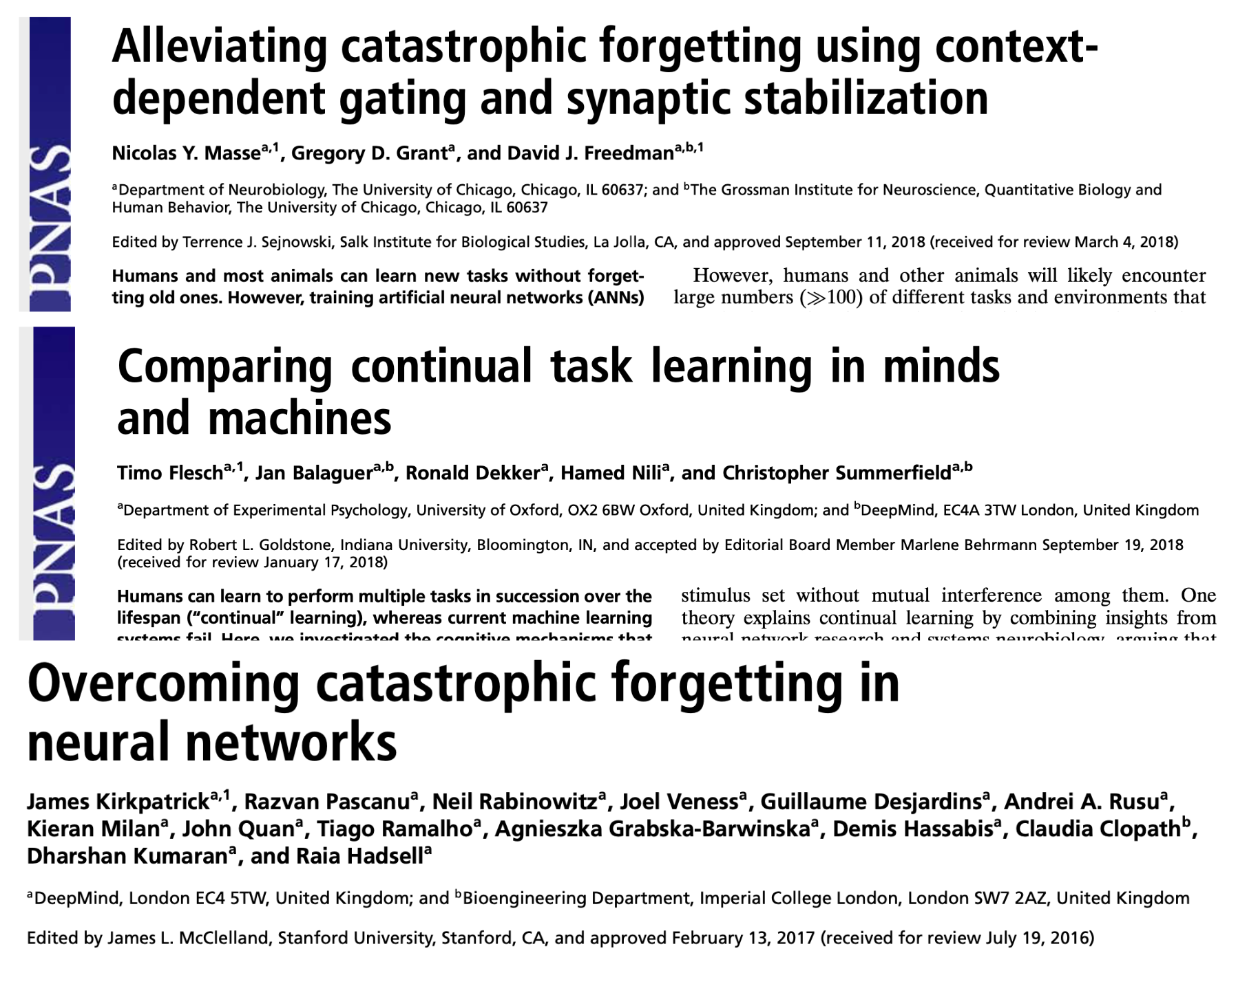
About 30 years later…
Notes:
Example content slide

Slide 17
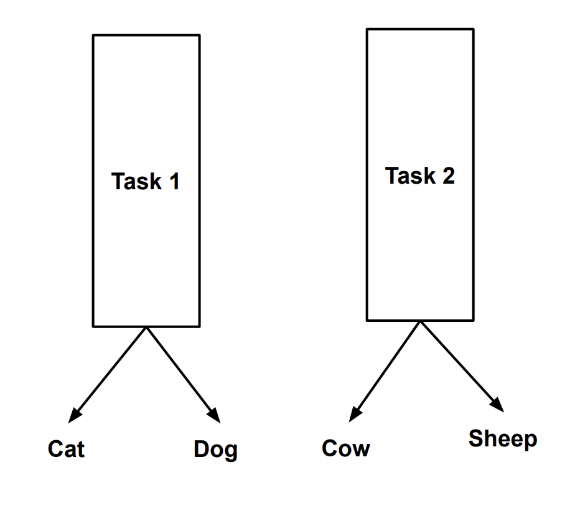
Mitigate Catastrophic Forgetting: solution 1
Stacking Single Task Experts is the most naïve solution
Notes:
Example content slide

Slide 18


Recall: Features of Human Learning
Can continuously learn different tasks
2. Improves on past and current tasks as they learn new tasks
3. Requires fewer samples to learn
Notes:
Example content slide

Slide 19
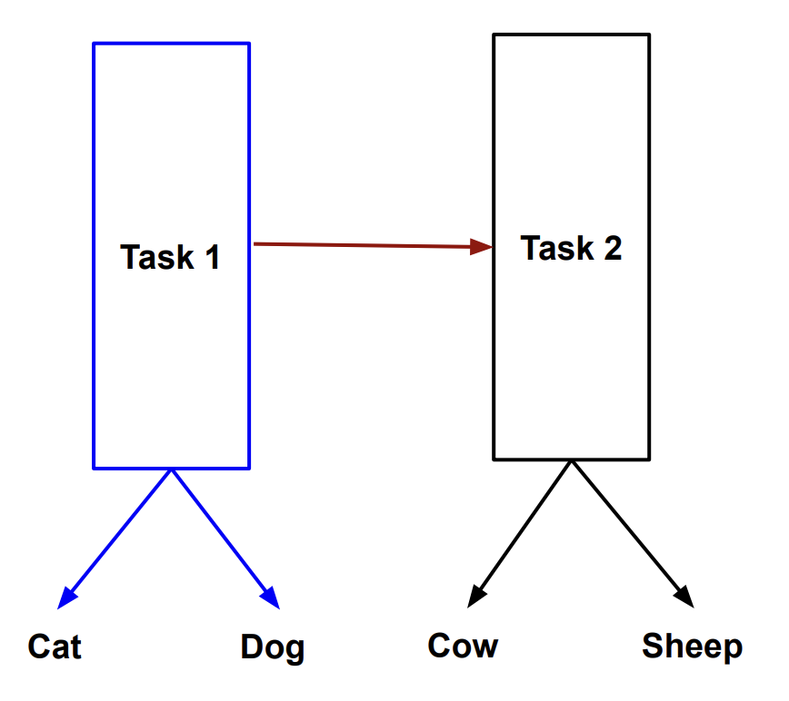
Mitigate Catastrophic Forgetting: solution 2
Task 2 performance gets better !!!
Task1 is frozen.
Solution to people with rich resources: dynamically expanding network
Notes:
Example content slide

Slide 20
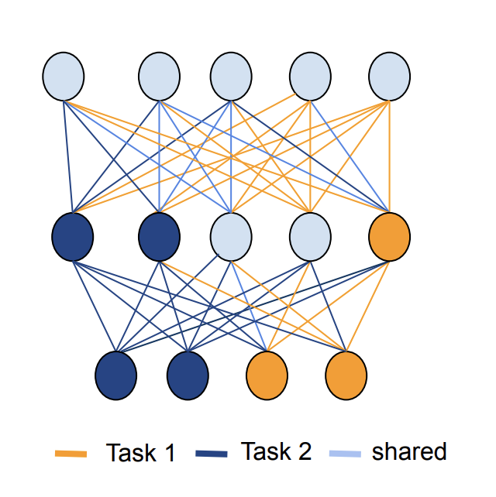
Mitigate Catastrophic Forgetting: solution 3
Reserve some parameters within the same model for Task1 and others for Task2.
Different papers use different criteria to guide the parameter allocation.
Solution to people with constrained resources: resource allocation
Notes:
Example content slide

Slide 21
Recall: Features of Human Learning
Can continuously learn different tasks
2. Improves on past and current tasks as they learn new tasks
3. Requires fewer samples to learn
Notes:
Example content slide

Slide 22
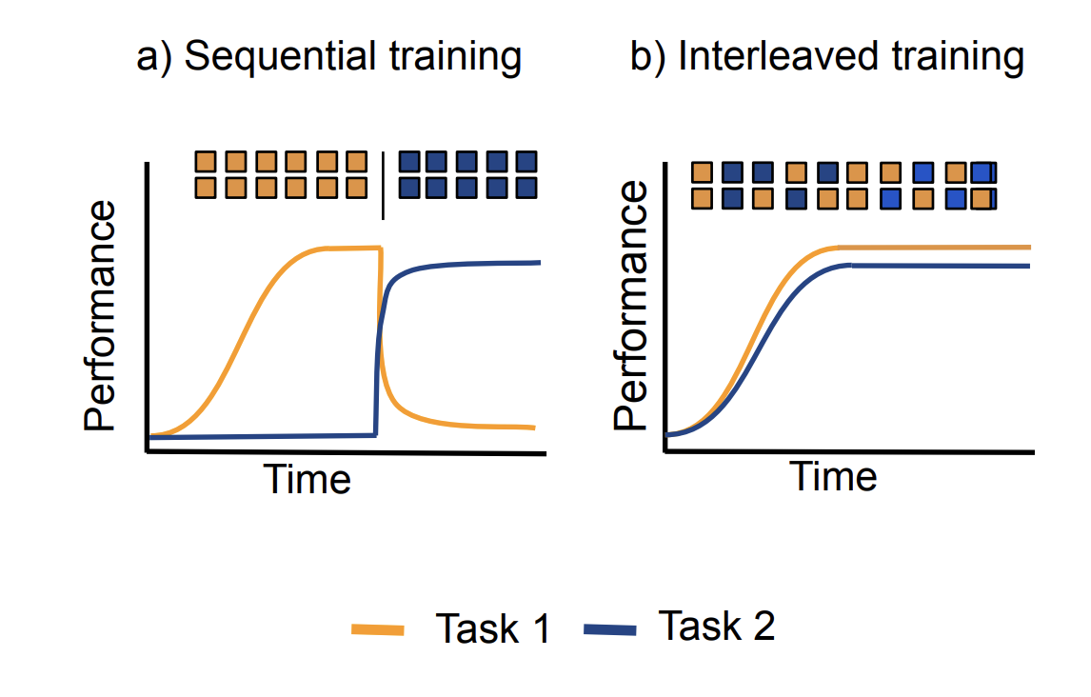
Mitigate Forgetting: solution 4
Rehearsing on past data while training on current task can improve past tasks!
Book Chapter: Van de ven, Soures, Kudithipudi, Continual Learning and Catastrophic Forgetting, arxiv 2024
Notes:
Example content slide

Slide 23
Recall: Features of Human Learning
Can continuously learn different tasks
2. Improves on past and current tasks as they learn new tasks
3. Requires fewer samples to learn
Notes:
Example content slide

Slide 24
CL solutions:
1. Increase model size (improves current task)
2. Do not increase model size (reallocate parameters)
3. Rehearse on previous data (improves past tasks)
Notes:
Example content slide

Slide 25
More challenges:
1. No task ID
2. Variable resource constraints
3. Include temporal dimension
Notes:
Example content slide

Slide 26
Which datasets can benefit from CL?
1. Streaming in nature
2. Target task changes over time
3. Data has distribution shifts over time
Notes:
Example content slide

Slide 27
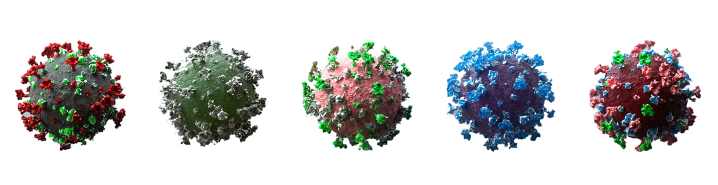
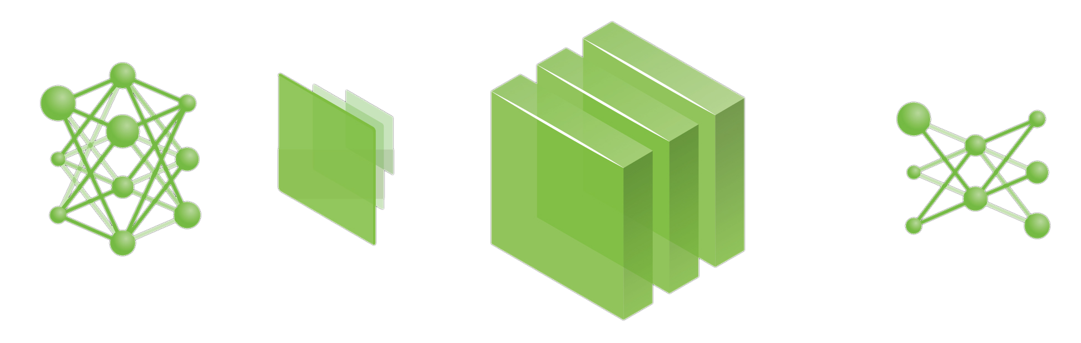
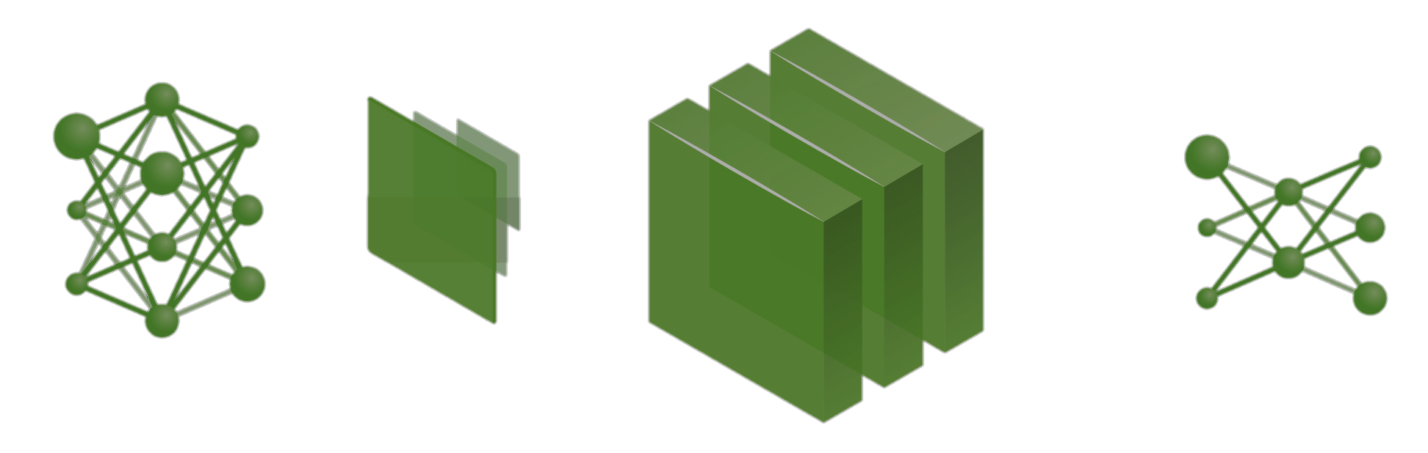
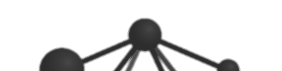


Example Case Study: COVID-19 Strains
Dec 2019
May 2020
Sept 2020
Dec 2020
Nov 2021
ALPHA
BETA
GAMMA
DELTA
OMICRON
Non-CL AI Algorithm
Fixed Network Architecture
Continual AI Algorithm
Kudithipudi, Pandit, NuAI Lab 2025
Dynamic Network Architecture

Slide 28
References
Kudithipudi, Dhireesha, et al. "Biological underpinnings for lifelong learning machines." Nature Machine Intelligence 4.3 (2022): 196-210.
Ben-David, S., Bethge, M., Cossu, A., Gepperth, A., Hayes, T., Hüllermeier, E., Kanan, C., Kudithipudi, D., Lampert, C., Mundt, M. and Pascanu, R., 2023. Continual Learning: Applications and the Road Forward.
Kudithipudi D, Daram A, Zyarah AM, Zohora FT, Aimone JB, Yanguas-Gil A, Soures N, Neftci E, Mattina M, Lomonaco V, Thiem CD. Design principles for lifelong learning AI accelerators. Nature Electronics. 2023 Nov;6(11):807-22.
CCN keynote by Dr. Kudithipudi: https://www.youtube.com/watch?v=-xmLMWC2YlI
Dey, Jayanta, et al. ”Simple Lifelong Learning Machines." (2021). (under review in TPAMI)
Notes:
Example content slide

Slide 29
Thanks for your attention! Questions?
jayanta.dey@utsa.edu
Notes:
End of course slide

